Slide 1
github.com/julienschmidt/httprouter
go get github.com/julienschmidt/httprouter

Slide 2
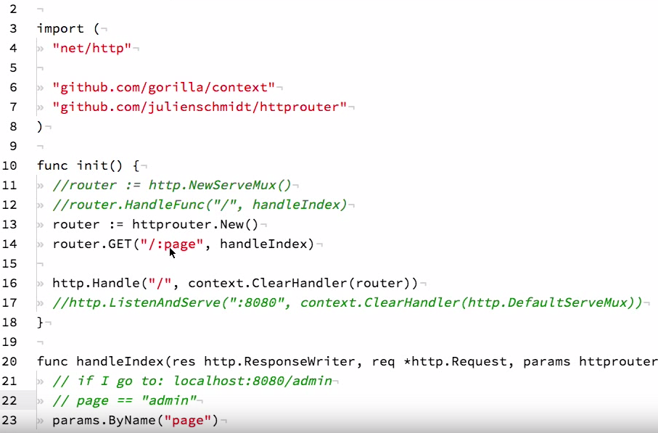

Slide 3
